Slide 1


AN HELPING HAND FOR DISABLED PEOPLE

Slide 2




Our team
Ajay Das k
Fathima Irfana T P
Muhammed Fais M T
Rabeeh C
CCV19CS002
CCV19CS019
CCV19CS007
CCV19CS015
GROUP NUMBER : 6
GUIDE NAME : NASRIN JUMANA K T

Slide 3
* Roban system is a way of setting up an Economic Environment to Help Disabled People with the Help of Modern IOT Technology. * All human needs can be fulfilled using Roban System * We use C++, modern IOT architecture and MQTT protocols. *Roban system is more economical than human labour.
1. Introduction

Slide 4
2.Formulation Of Objectives
Economic
Very cheper than human labour.
A suitable companion for disabled people
Easy to maintain
Help disabled people to fullfill their Needs
Module wise architecture
Daily life applications
Large scale compactibility
Wide range of application,applicable to every physical needs
Can be connect infinite nodes and large scale application

Slide 5
3. Task Identification And Allocation
Ajay Das k
Fathima Irfana T P
Muhammed Fais M T
Rabeeh C
Overall h/w
Fullfill needs
Security
Voice control
Overall connecting the modules and hardwares
Fullfilling the basic needs. Providing support to patients.
Security and surveillance to the patient and surrounding.
Controling all phyical objects using commands and guesters.

Slide 6
Literature Survey
Ref.Date:20/10/2022
PAPER 1 :Enabling automation and-edge intelligence over resource const
Authors : Mansoor Nasir a , Khan Muhammad b,⇑ , Amin Ullah c , Jamil Ahmad a , Sung Wook Baik d , Muhammad Sajjad a,e,⇑ aDigital Image Processing Laboratory, Department of Computer Science, Islamia College Peshawar, Peshawar 25000, KP, Pakistan b Visual Analytics for Knowledge Laboratory (VIS2KNOW Lab), School of Convergence, College of Computing and Informatics, Sungkyunkwan University, Seoul 03063, Republic of Korea c CORIS Institute, Oregon State University, Corvallis, OR 97331, USA d Sejong University, Seoul 143-747, Republic of Korea e Color and Visual Computing Lab, Department of Computer Science, Norwegian University of Science and Technology (NTNU), Gjøvik 2815, Norway
TOPIC
PUBLICATION YEAR\
/JOURNAL
FEATURES
PROS
CONS
Enabling automation and-edge intelligence over resource const
2022
Neurocomp,
Science direct www.Elsevier.Com
Artificial intelligence
Edge intelligence
IoT Smart home
Deep learning
Human fall detection
CNN Embedded iot
Infinite nodes
Easy to implement
Daily life application
Security, safety, privacy, and low energy consumption
Need to be trained according to the situation
6/17/2023
6

Slide 7
Literature Survey
Ref.Date:29/10/2022
PAPER 2 :Interacting with a Digital Twin using Amazon Alexa
Authors : Stefan Wellsandta,*, Mina Foosheriana, Klaus-Dieter Thobena,b aBIBA - Bremer Institut für Produktion und Logistik
GmbH, Hochschulring 20, 28359 Bremen, Germany bUniversity of Bremen, Faculty of Production Engineering, Badgasteiner Straße
1, 28359 Bremen, Germany
TOPIC
PUBLICATION YEAR/
JOURNAL
FEATURES
PROS
CONS
Interacting with a Digital Twin using Amazon Alexa
2020
Science Direct
(Stefan Wellsandt. et al. / Procedia Manufacturing 52 (2020) 4–8)
Alexa Embedding
Digital twin
Voice on interface
Using digital twin technology
Embedding IOT in large scale ways
Easy and multiple interaction with IOT
Low transcription accuracy
Need noise cancelation on voice input

Slide 8
Literature Survey
Ref.Date:01/11/2022
PAPER 3 :Amazon Alexa traffic traces
Authors : Rub´en Barcel´o-Armada, Ismael CastellUroz*, Pere Barlet-Ros
( Universitat Polit`ecnica de Catalunya )
TOPIC
PUBLICATION YEAR/
JOURNAL
FEATURES
PROS
CONS
Amazon Alexa traffic traces
8 January2022,
Science direct www.Elsevier.Com
Alexa Embedding
IOT Security
Voice on interface
Knowing the traces of IOT embedded system
Sharing the 2 datasets that can help conduct privacy and security studies from the amazon dot ,echo speakers
Responding to voice commands require devices to listen the voices
Need a word to
wake
Loss in privacy

Slide 9
Literature Survey
Ref.Date:01/11/2022
PAPER 4 :IoT-based electrosynthesis ecosystem
Author : Sepideh Radmannia,
Milad Naderzad∗ ChemIOT, Istanbul, Turkey
TOPIC
PUBLICATION YEAR\
/JOURNAL
FEATURES
PROS
CONS
IoT-based electrosynthesis ecosystem
2018
Science Direct
(Internet of Things 3– 4 (2018) 46–51 C)
IoT-Internet of Things
IoCT- Internet of Chemical Things
Automated ecosystem
Electrosynthesis machine
Scaling up the coulometry procedure to be used in industrial companies
Predictive Maintenance
Energy Management
Need to be in Network
High data transfer rate (Band width)

Slide 10
Literature Survey
Ref.Date:03/11/2022
PAPER 5 : Access control and surveillance in a smart home
Authors :Cristina Stolojescu-Crisana,∗ , Calin Crisanb , Bogdan-Petru Butunoi c a Department of Communications, Politehnica University of Timisoara, Timisoara, Romania b SafeFleet Telematics, Timisoara, Romania c Department of Computer Science, West University of Timisoara, Timișoara, Romania
TOPIC
PUBLICATION YEAR/
JOURNAL
FEATURES
PROS
CONS
Access control and surveillance in a smart home
2022
Science Direct_ High-Confidence Computing _(100036 )
Access control
Internet of things
Security Smart
Homes Video surveillance
Access control and security system. Qtoggle
Video surveillance. MotionEye
Easy and multiple interaction with IOT Access control and security using QToggle
Need to be in Network
High data transfer rate (high band width)

Slide 11
Literature Survey
Ref.Date:10/11/2022
PAPER 6 : Smart IOT Surveillance Multi-Camera Monitoring System
Authors :Husniza Razalli , Mohammed Hazim, Aizat Syazwan Suhemi
Faculty of Information Science & Engineering. Management & Science University, Shah Alam, Selangor, Malaysia
TOPIC
FEATURES
PROS
CONS
PUBLICATION YEAR/
JOURNAL
Smart IOT Surveillance Multi-Camera Monitoring System
2019
IEEE 7th Conference on Systems, Process and Control (ICSPC 2019), 13–14 December 2019, Melaka, Malaysia
IOT
Edge Computing, surveillance camera
live video
Video analytics
Video streaming
Security Surveillance Movement Tracking System
Video surveillance.
Easy and multiple interaction with IOT Access control and security
Need to be in Network
High data transfer rate
6/17/2023

Slide 12
Literature Survey
Ref.Date:13/11/2022
PAPER 7 : TrustBuilder: A non-repudiation scheme for IoT cloud applications
Authors :Fei Chena , Jiahao Wanga , Jianqiang Li a , Yang Xub , Cheng Zhang b , Tao Xiangc,∗ a College of Computer Science and Engineering, Shenzhen University, China b College of Computer Science and Electronic Engineering, Hunan University, Changsha, China c College of Computer Science, Chongqing University, Chongqing, China
TOPIC
PUBLICATION YEAR/
JOURNAL
FEATURES
PROS
CONS
TrustBuilder: A non-repudiation scheme for IoT cloud applications
18 February 2022
Computers & Security 116 (2022) _ScienceDirect Computers & Security
Non-repudiation
IoT Cloud computing
Blockchain Trust
Blockchain based approach
More secure
Complexity in implimentation

Slide 13
Literature Survey
Ref.Date:17/11/2022
PAPER 8 : Accuracy determination using deep learning technique in cloud-based IoT sensor environment
Authors : B. Raviprasad a,* , Chinnem Rama Mohan b , G. Naga Rama Devi c , R. Pugalenthi d , L.C. Manikandan e , Sivakumar Ponnusamy f a Marri Laxman Reddy Institute of Technology and Management, Hyderabad, 500043, India b Department of Computer Science and Engineering, Visvesvaraya Technological University, Belgaum 590018, India c Department of Computer Science and Engineering, CMR College of Engineering and Technology, Kandlakoya, Medchal, Hyderabad, 501401, India d Department of Computer Science and Engineering, St.Joseph’s College of Engineering, OMR, Chennai, 600119, India e Department of Computer Science and Engineering, Valia Koonambaikulathamma College of Engineering and Technology, Thiruvananthapuram, Kerala, India f Department of Computer Science and Engineering, SRM Institute of Science &Technology, Delhi NCR Campus, Modinagar Ghaziabad, Uttar Pradesh, 201204, India
TOPIC
PUBLICATION YEAR/
JOURNAL
FEATURES
PROS
CONS
Accuracy determination using deep learning technique in cloud-based IoT sensor environment
2022
Measurement: Sensors 24 (2022) 100459
ScienceDirect
Network complexity
Intrusion detection
Systems Image and
Signal processing IoT environment
Deep learning
Overcomes the longer practice times and low recognition accuracy of modern machine learning algorithms.
Increases classification performance. In terms of classification accuracy, predictive accuracy, sensitivity, and false alarm rates features can be extracted through CNN at different levels.
Data depends on sensor .
The data change with environment.
6/17/2023
13

Slide 14
Literature Survey
Ref.Date:20/11/2022
PAPER 9 : Self secured model for cloud based IOT systems
Authors : G Soniya Priyatharsini a,* , A. Jyothi Babu b , M. Gnana Kiran c , Sathish Kumar P.J.d , Nelson Kennedy Babu C.e , Aleem Ali f a Department of Computer Science and Engineering, Dr. M.G.R. Educational and Research Institute, Chennai, Tamil Nadu, 600095, India b Department of MCA, Sree Vidyanikethan Engineering College, Tirupati, Andhra Pradesh, India c Department of Engineering Physics, K L University, Vaddeswaram, Andhra Pradesh, 522302, India d Department of Computer Science and Engineering, Panimalar Engineering College, Chennai, 600123, India e Department of Computer Science and Engineering, SIMATS School of Engineering, SIMATS, Chennai, Tamilnadu, India f Department of Computer Science &Engineering, UIE, Chandigarh University,Mohali, Punjab, India
TOPIC
PUBLICATION YEAR/
JOURNAL
FEATURES
PROS
CONS
Self secured model for cloud based IOT systems
2022
Measurement: Sensors 24 (2022)100490
ScienceDirect
IoT Cloud add value services
Federated cloud
Hardware and software products
Secure self-identification of IoT devices
IoT cloud-based architecture
Security concern architecture
Need to be in Network
High data transfer rate
6/17/2023
14

Slide 15
Literature Survey
Ref.Date:24/11/2022
PAPER 10 : Taking MQTT and NodeMcu to IOT: Communication in Internet of Things
Authors : Monika Kashyap*, Vidushi Sharma, Neeti Gupta
Gautam Buddha University,Greater Noida-201308 India
TOPIC
PUBLICATION YEAR/
JOURNAL
FEATURES
PROS
CONS
Taking MQTT and NodeMcu to IOT: Communication in Internet of Things
2018
International Conference on Computational Intelligence and Data Science (ICCIDS 2018)
ScienceDirect
Arduino, ESP8266, HiveMQ, Internet Of Things(IOT), Message Queuing Telemetry Transport (MQTT)
Simplicity of remote web access through Wi-Fi,
IoT cloud-based architecture
Never lost the data while it is connected with Wi-Fi and it saves the data in a queue.
Need to be in Network
15

Slide 16
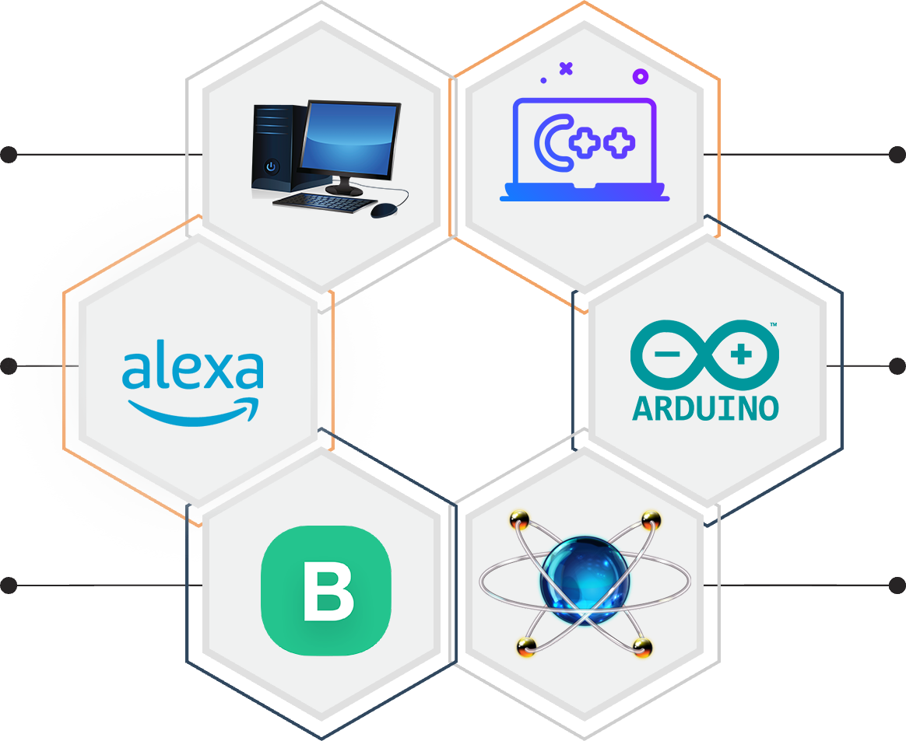
4.Requirments
Pc system
C++
Windows 7+,4 gb of Ram
C++ language is used for code
Alexa
Arduino ide
Amazon echodot speaker
To flash hende MCU and micro controllers
Blynk iot
Proteus
Blynk iot web server iot app
Circuit designing and testing

Slide 17
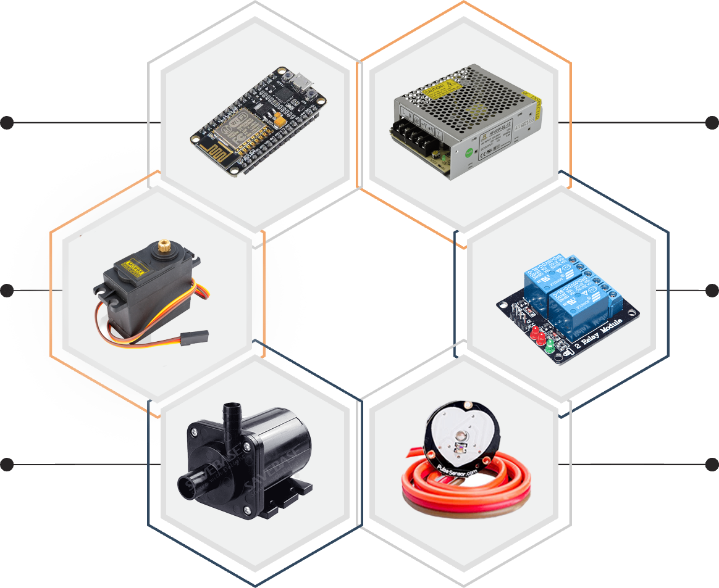
4.Requirments
Node MCU
S M P S
Micro controller bord with wifi
The power supply
Servo motor
Relay module
Used to lift and slide things
Used to trigger current flow
Pump/valve
Sensors
To controll liquid or air flow
Used to input the data

Slide 18
5.Architecture of Internet of Things (IoT)
These Sensors or Actuators accepts data(physical/environmental parameters), processes data and emits data over network.
Sensing Layer
Collecting data and aggregating data then converting analog data of sensors to digital data etc
Network Layer
Data processing Layer
Here data is analyzed and pre-processed before sending it to data center from where data is accessed by software applications often termed as business applications where data is monitored and managed and further actions are also prepared.
Application Layer
Data centers or cloud is management stage of data where data is managed and is used by end-user applications like agriculture, health care, aerospace, farming, defense, etc.

Slide 19
6. Formulation of Design
Code/conditions
sensors
Micro Controller
Server
Servo,Relay,Drivers
Real world

Slide 20


7. Modules
1
Bed and Ventilation
Module
2
Basic
Needs
Module
3
Security And Entertainment Module
4
Patient Monitor
Module

Slide 21
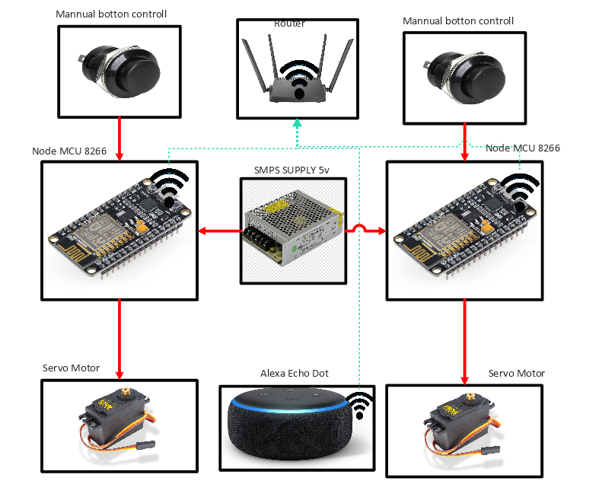
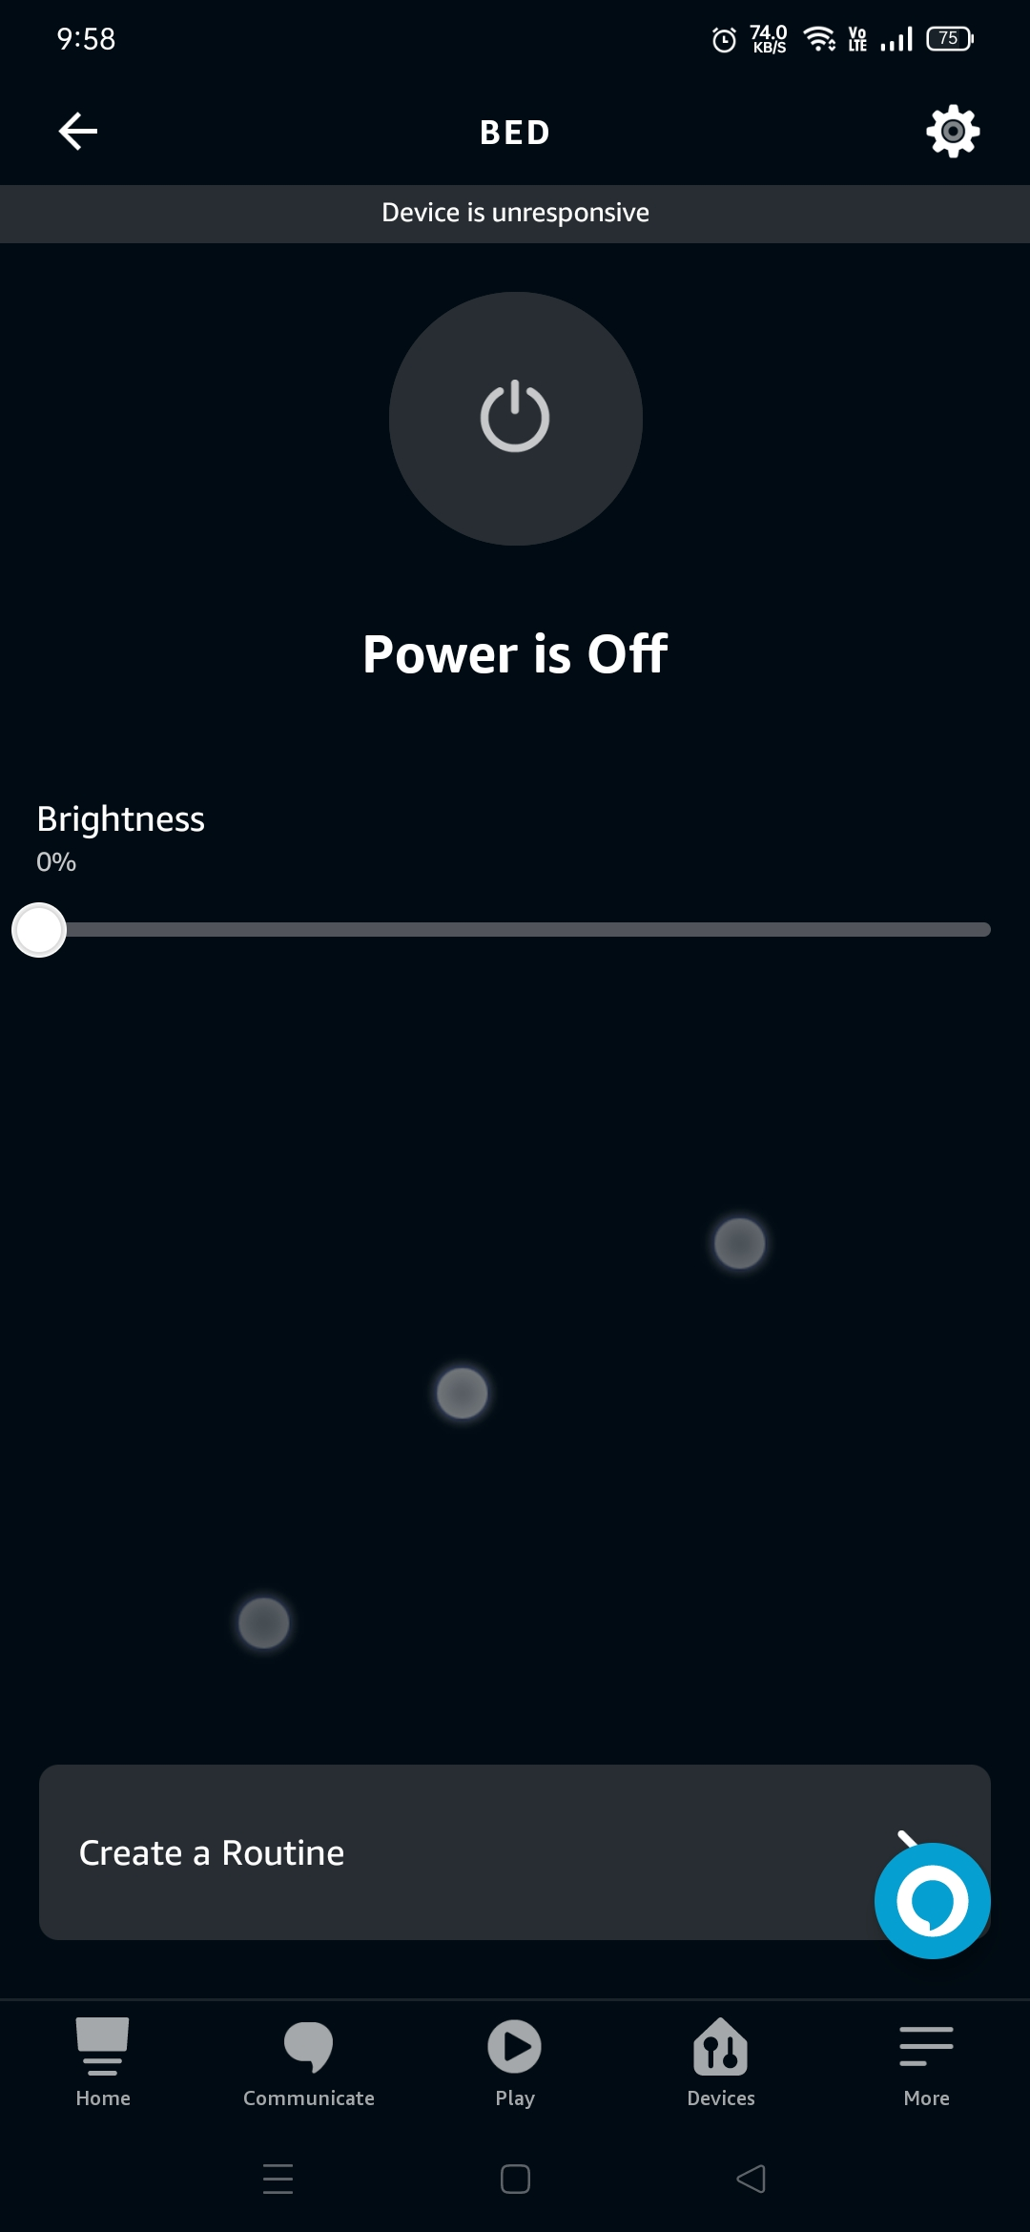
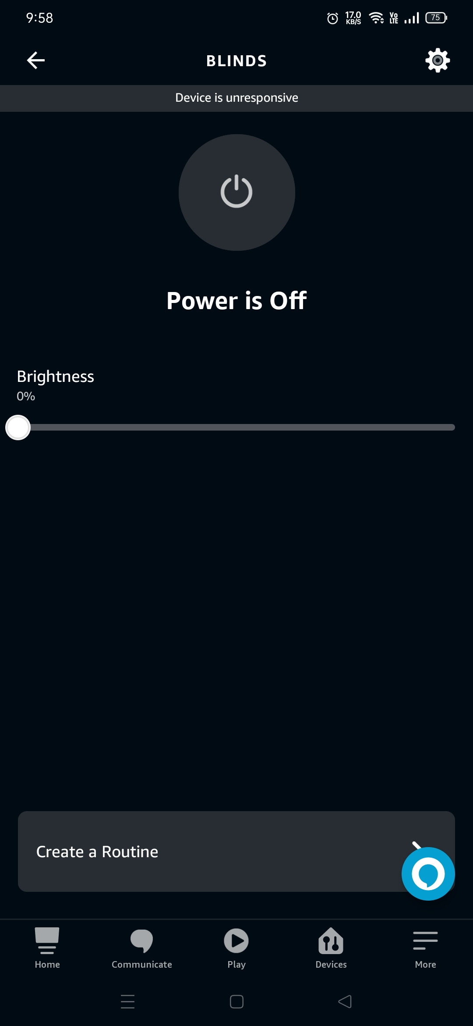
1.Bed And Ventilation Module
Control the angle of curtain/blinds.
Voice command enabled.
Easy to connect over the Internet.
Manual switches enabled.
Wide compatible with IOT platforms.
Application control is also available.

Slide 22
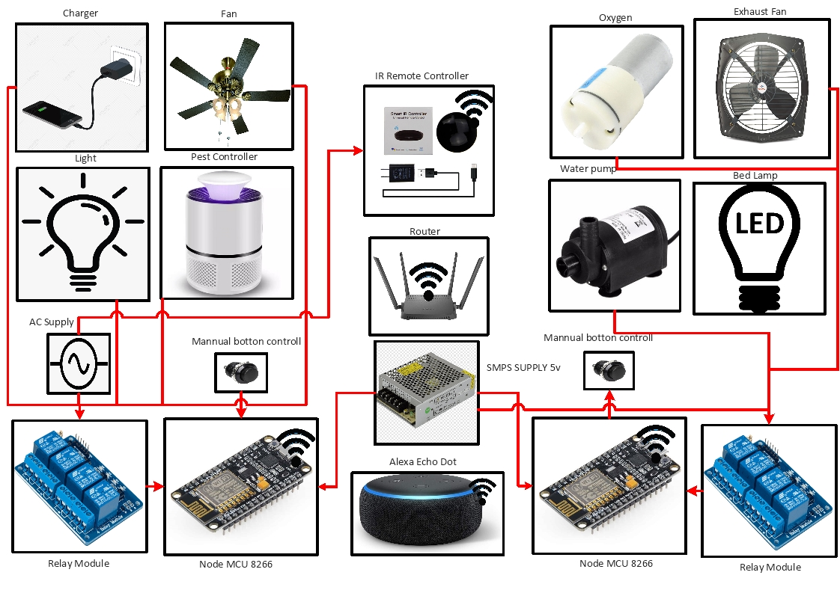
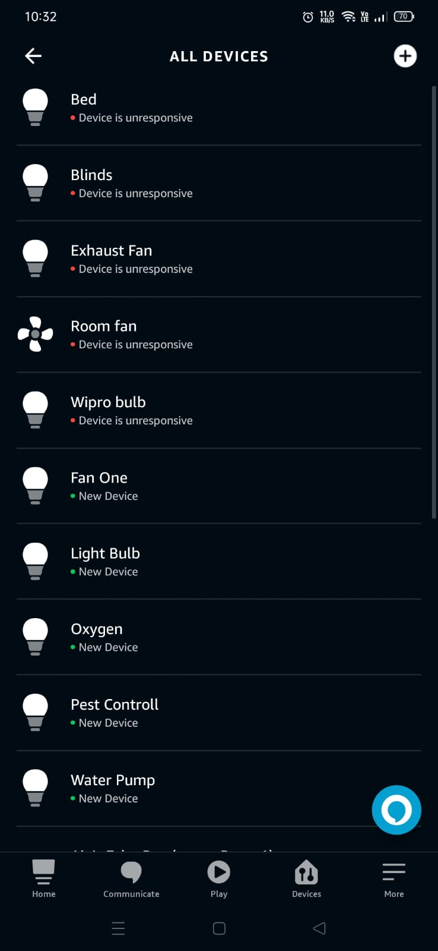
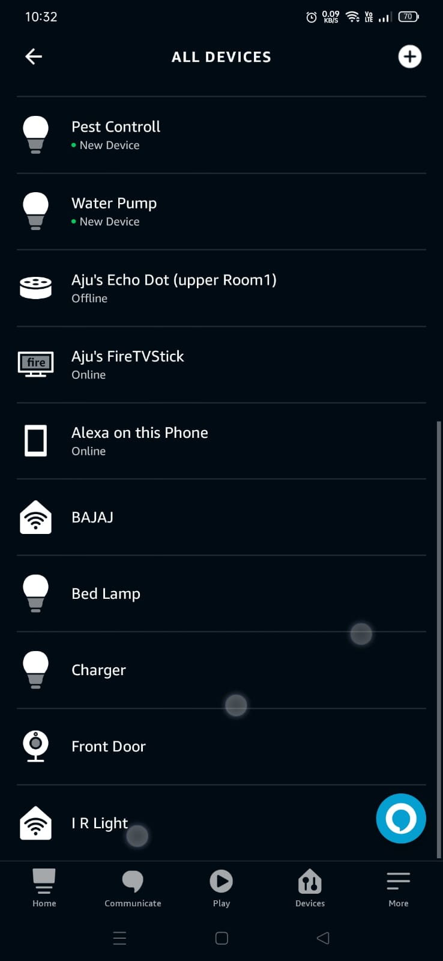
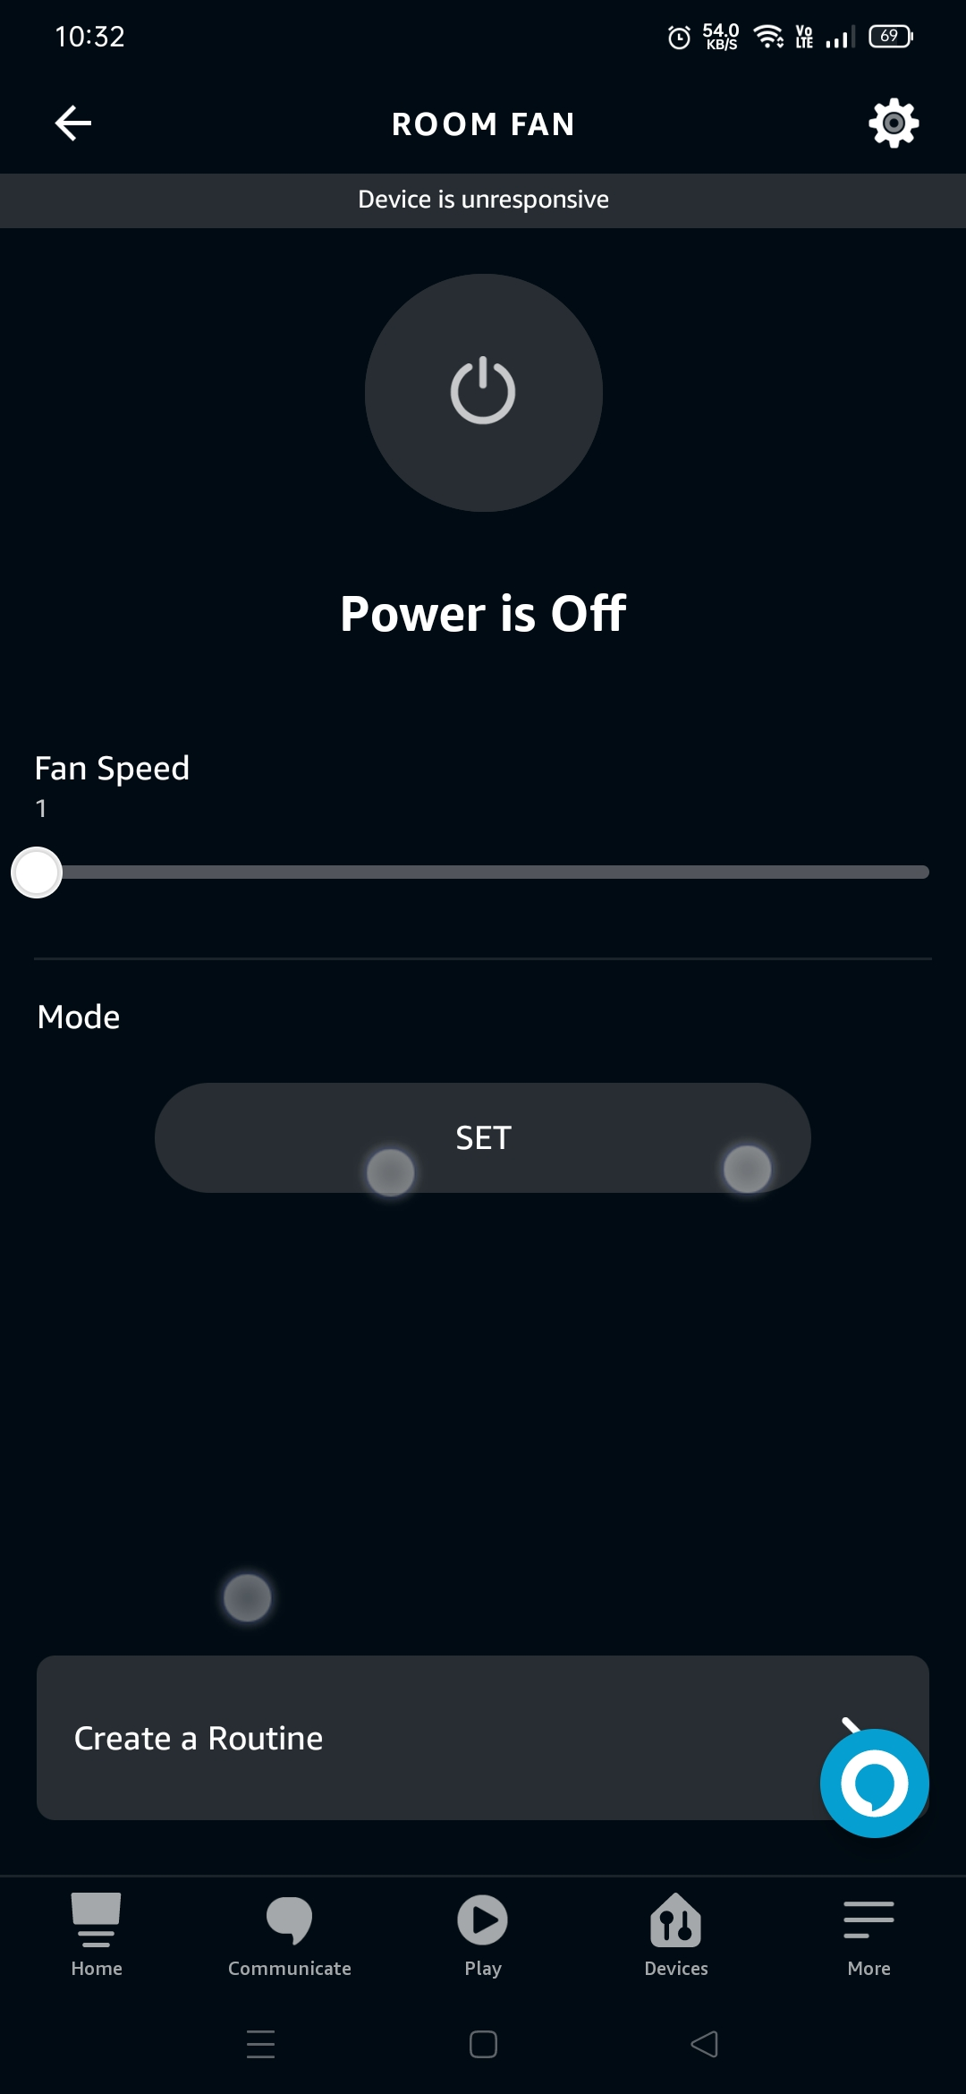
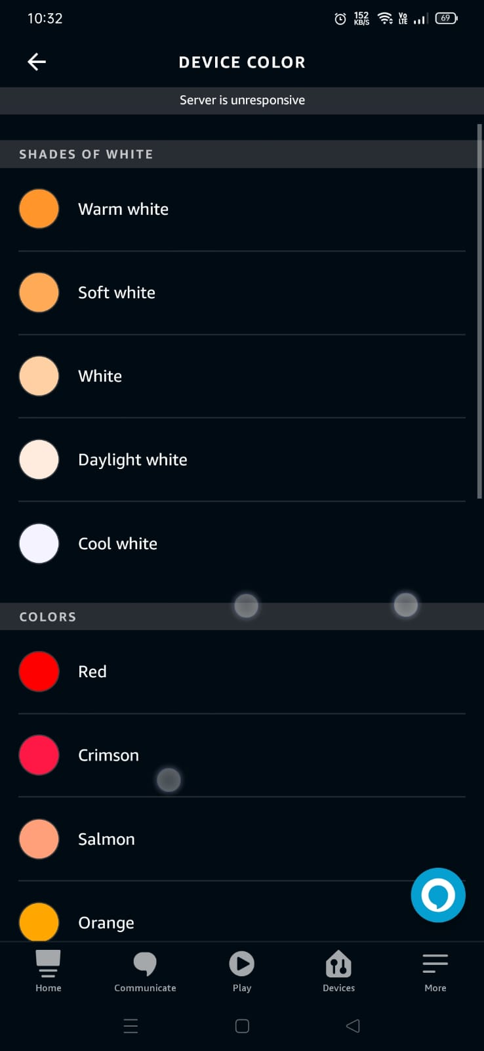
2.Basic Needs Module
Control the Daily life Appliances.
Voice command enabled.
Easy to connect over the Internet.
Manual switches enabled.
Infra red Controlled devices are also connected with IOT.
Wide compatible with IOT platforms.
Application control is also available.

Slide 23
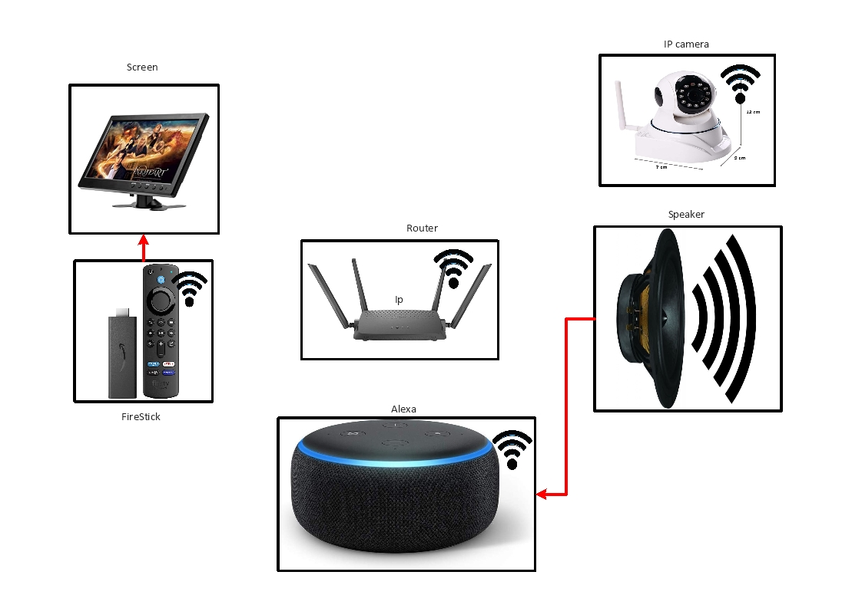

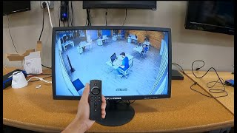
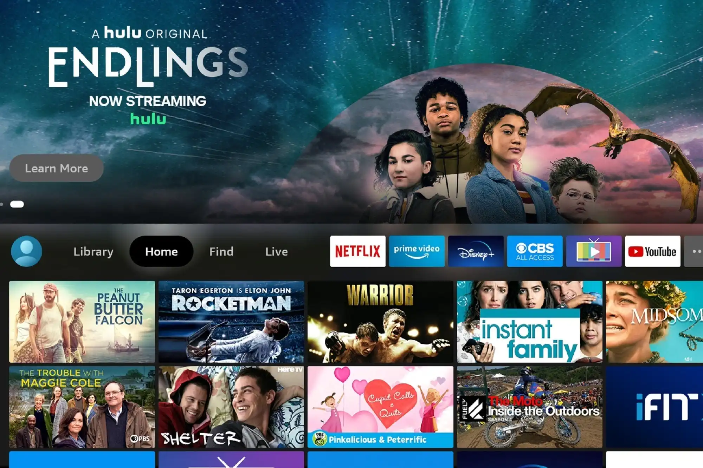
3. Security And Entertainment Module
Control the Daily life Appliances.
Voice command enabled.
Easy to connect over the Internet.
Entertainment And Monitor the premises.
Wide compatible with IOT platforms.
Remote Control Available.
Multiple Platforms.

Slide 24
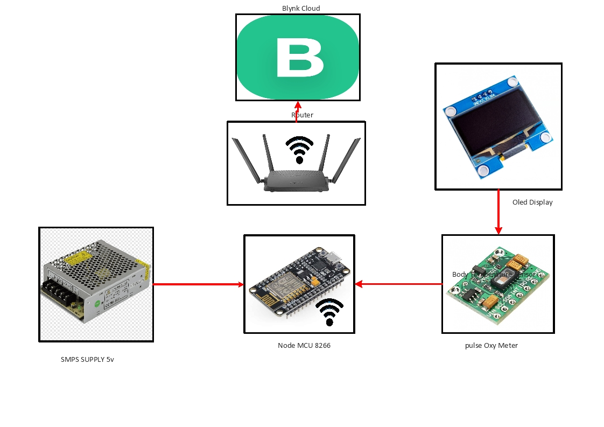
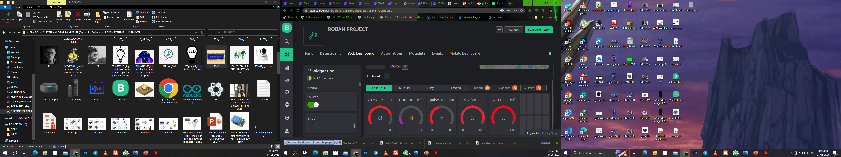
4.Patient Monitor Module
Monitor the patient anywhere around the world.
Easy to connect over the Internet.
Graphical charts and levels.
Automation And Triggering On Specific Conditions.

Slide 25
7. Project progress
Completed around 90% of the project
Implemented five modules (bed and ventilation, basic needs,
patient monitor module, medical aid module, security and monitoring)
Connected the modules with the IOT environment
Activated voice assistance with IoT devices
Calibrated sensors according to the environment

Slide 26
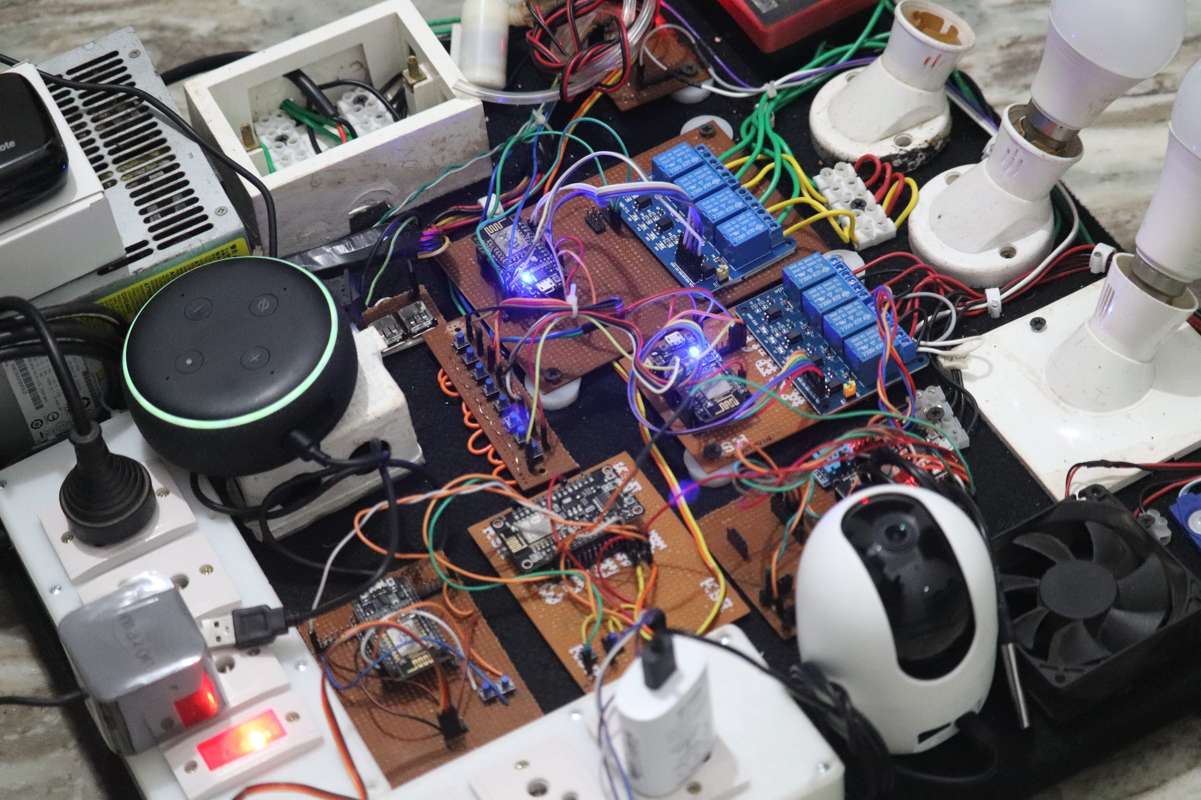
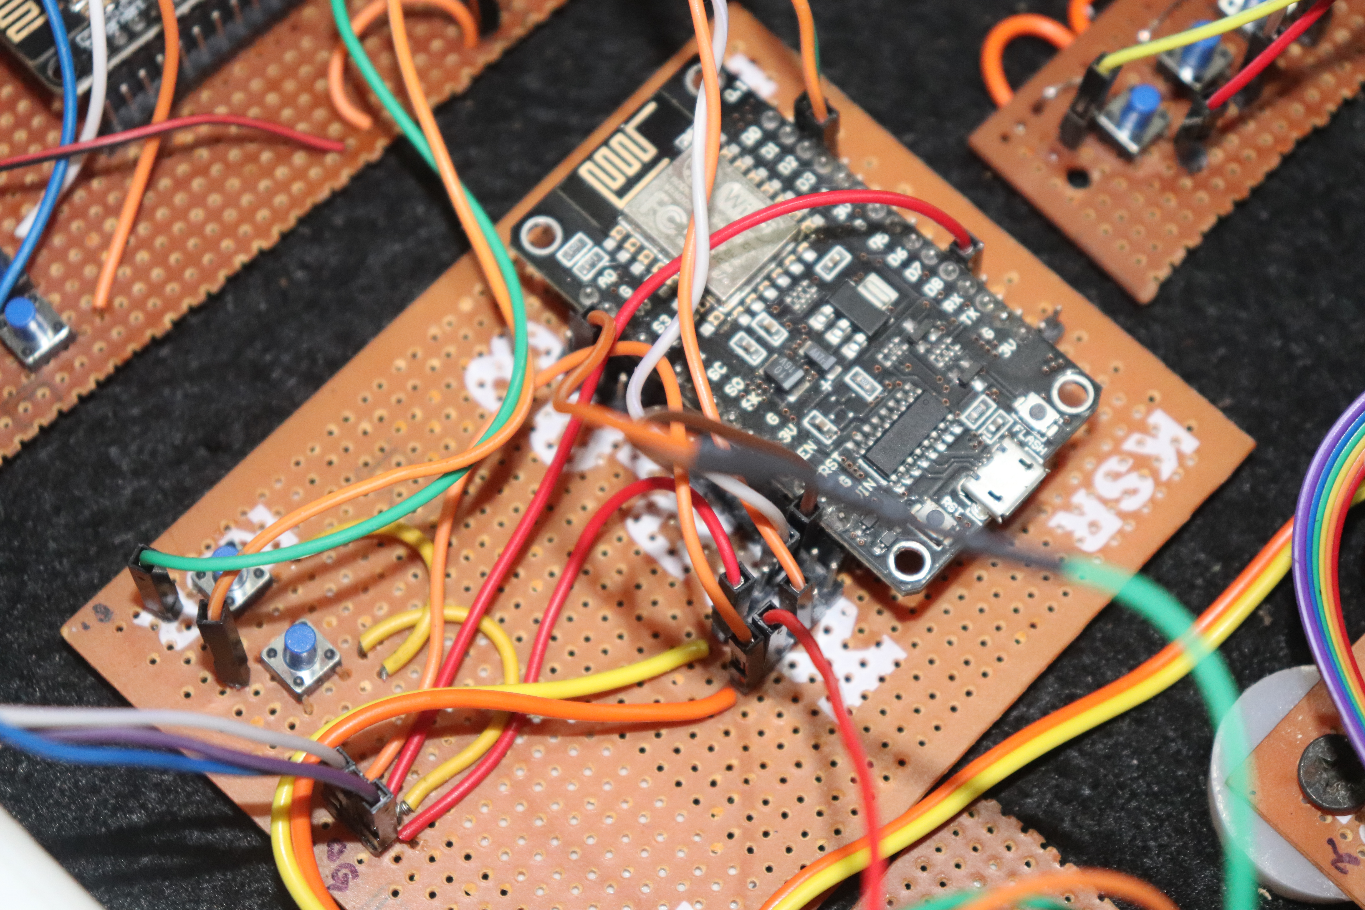
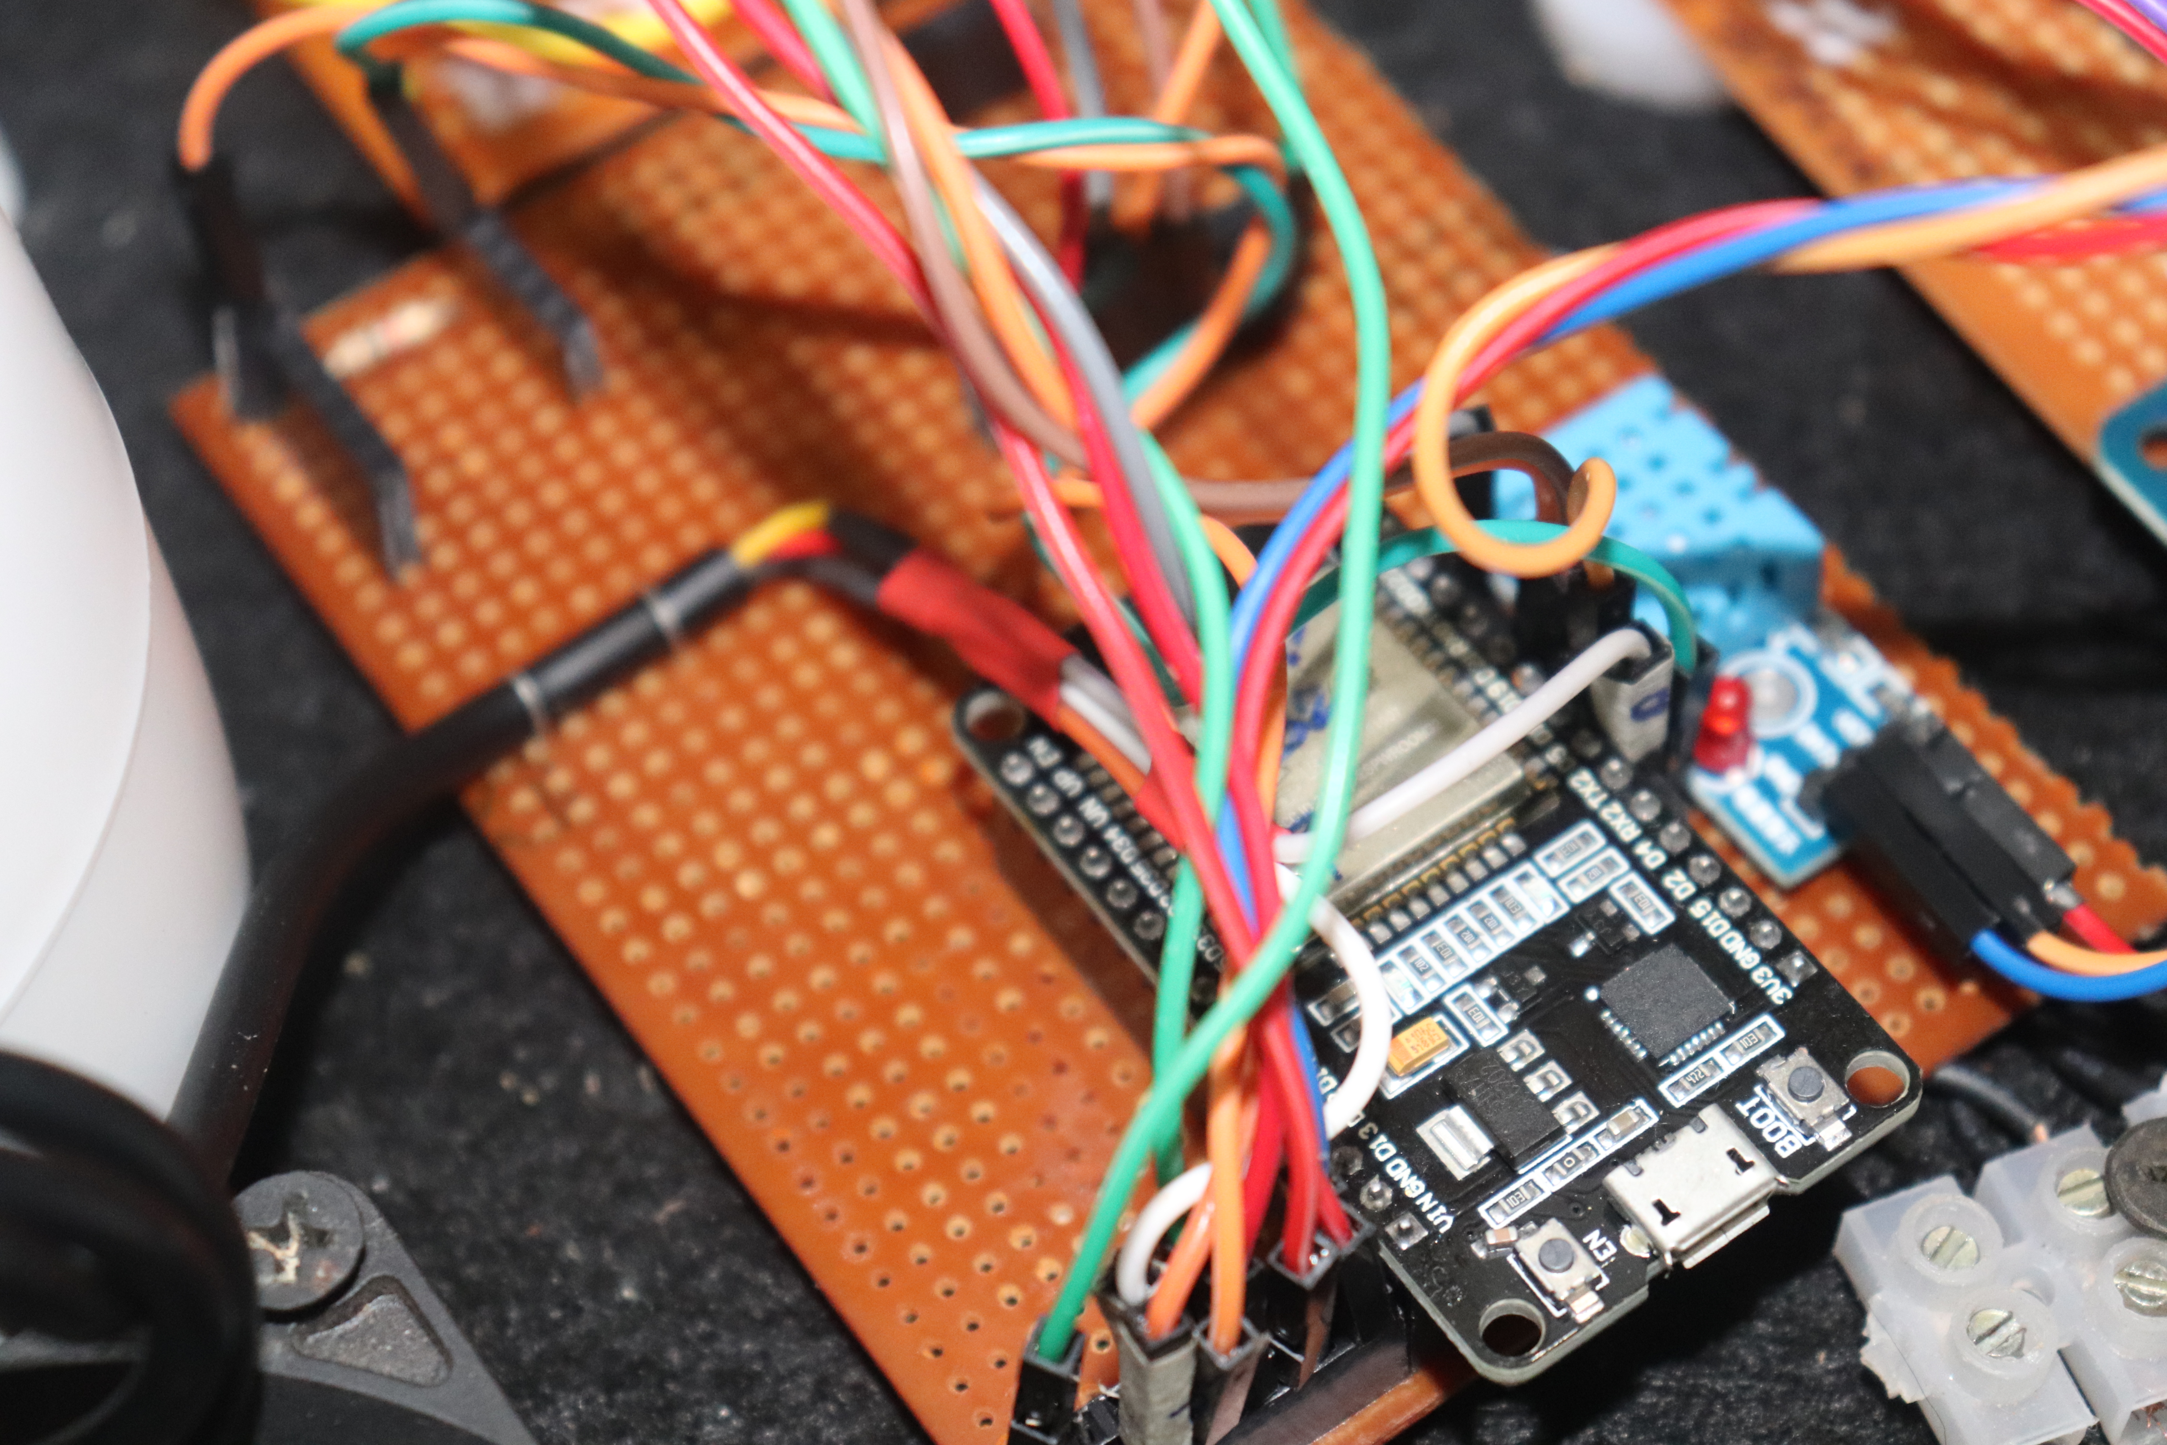
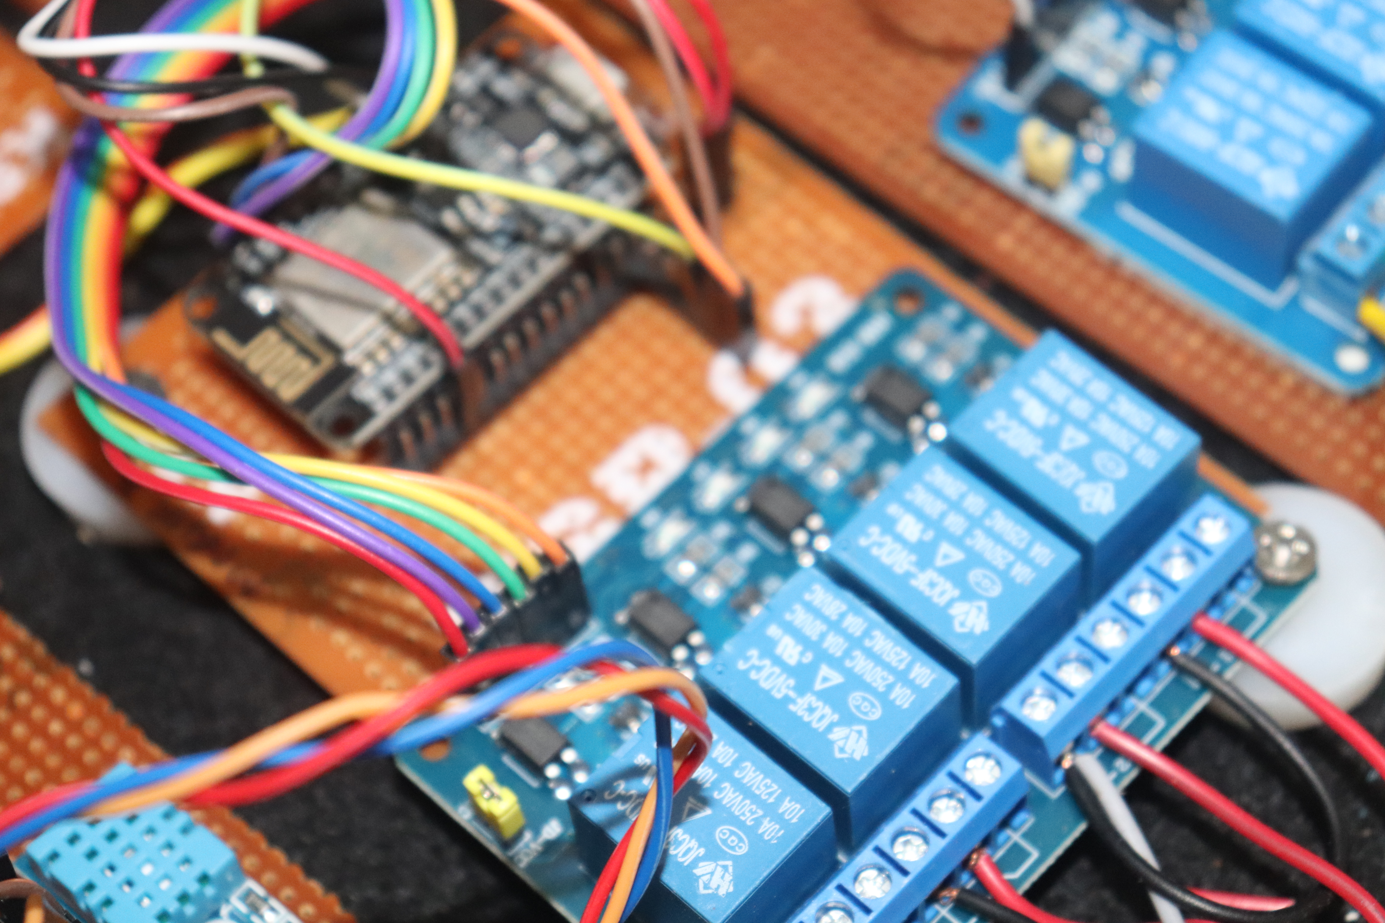
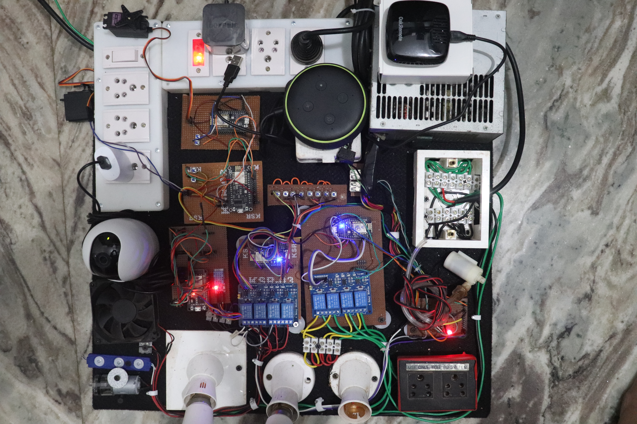
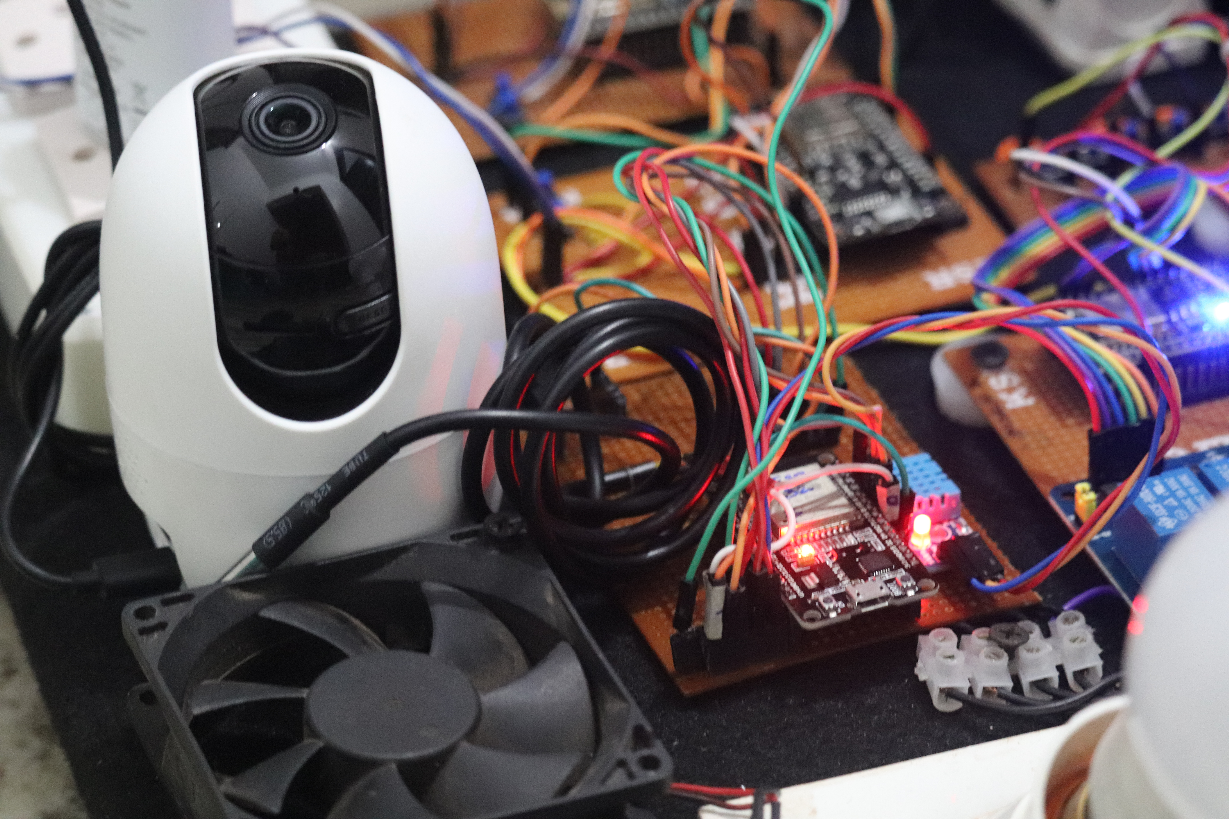
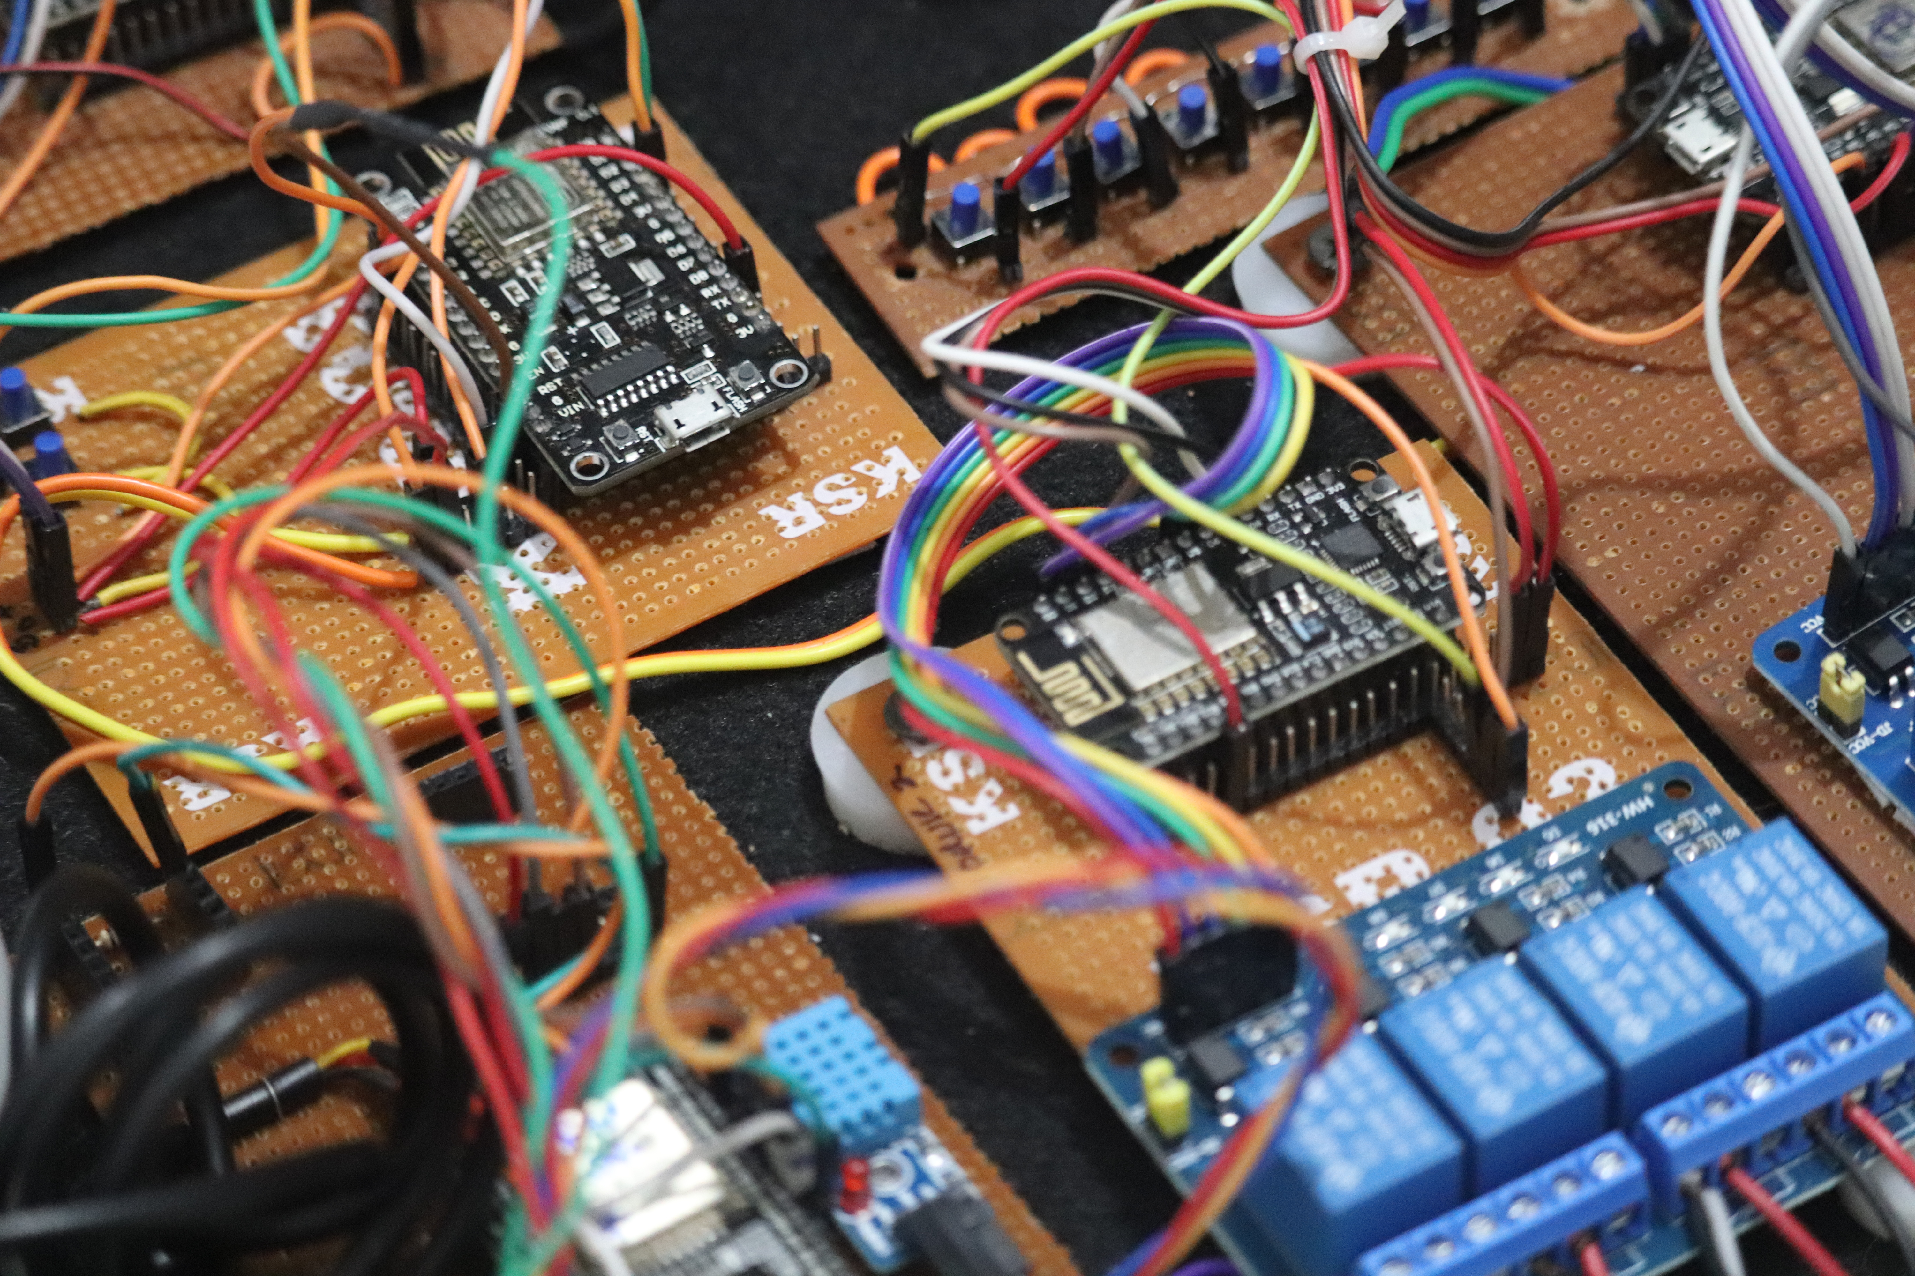
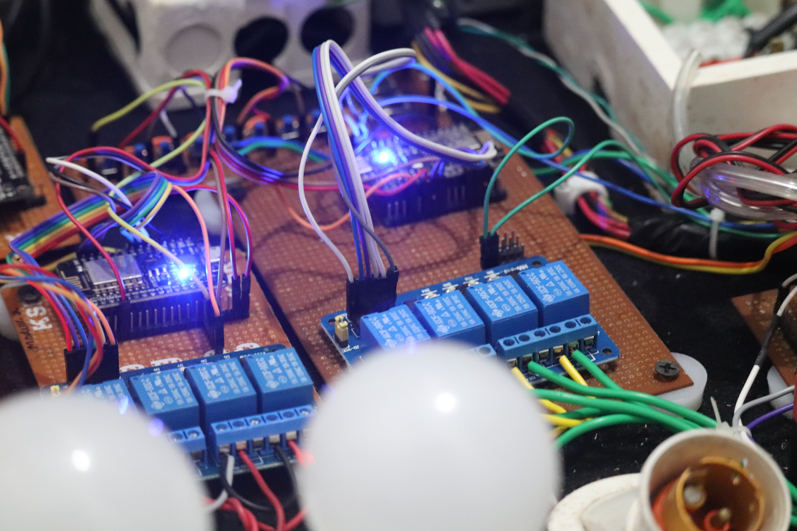
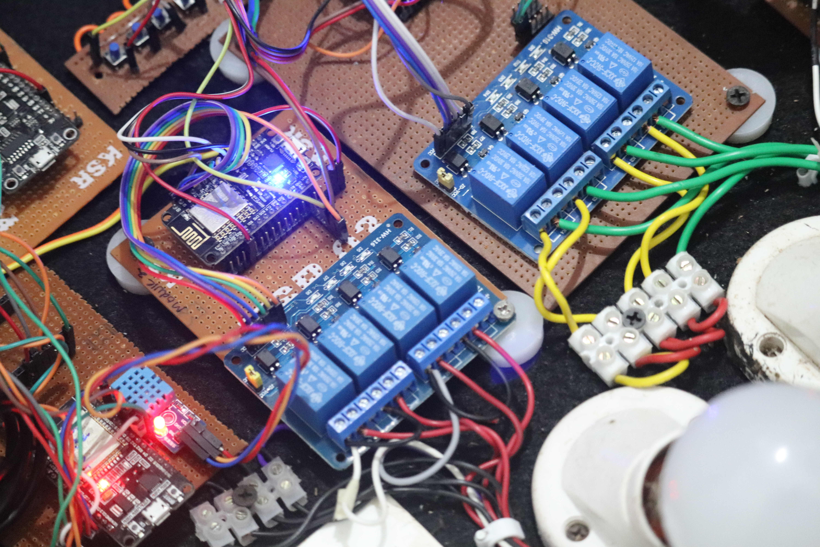

Slide 27
Reference
Git hub
Stack overflow
Knibus
Aurdino community

Slide 28
Thank you !
Any questions ?

